Slide 1

Lesson 3.1: Abstraction and generalization
Microsoft Philanthropies TEALS Program
Introduction to Computer Science

Slide 2
Abstraction and generalization
After this lesson, you will be able to...
Define the following terms in a computer science context:
abstraction
generalization
Recognize opportunities to improve algorithms by abstracting or generalizing parts into sub-procedures.
Build custom command blocks in Snap!.

Slide 3
Today’s plan
Do now
Lecture, demo, and introduce activity
Lab: Drawing shapes
Debrief
Notes:
Duration Description
5 minutes | Do Now
10 minutes | Introduce terminology, introduce activity
20 minutes | Drawing Shapes (Again) activity
15 minutes | Debrief and wrap-up

Slide 4

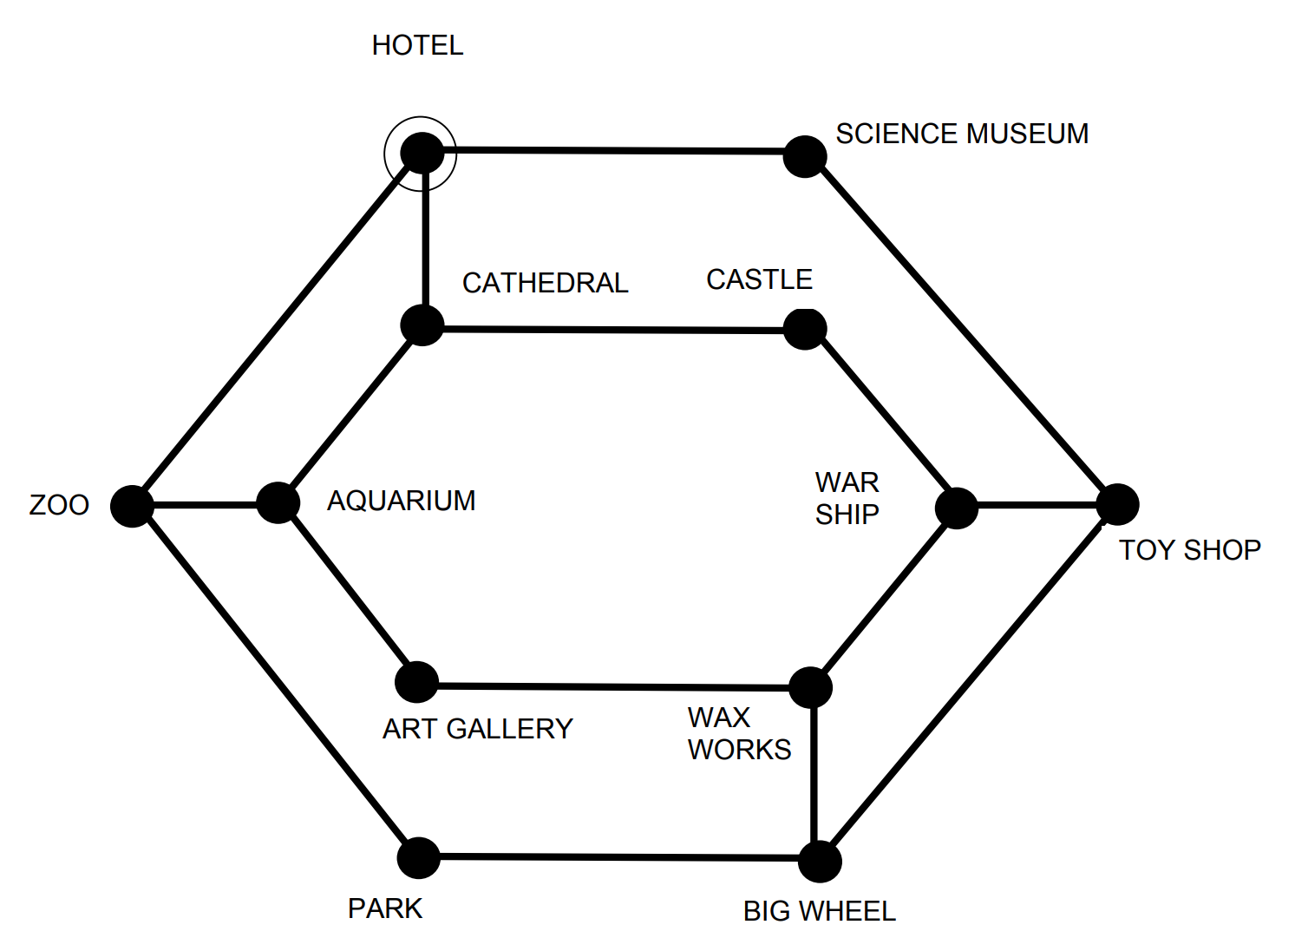
Do now 3.1: Guided tour
Can you plan a route, starting at the hotel, so that tourists can visit every tourist attraction just once and be back to the hotel?
Notes:
The full Guided Tour City Tube Map activity with one possible solution. (Credit: Queen Mary University of London)
https://teachinglondoncomputing.files.wordpress.com/2014/12/activity-tourguide.pdf

Slide 5

What is abstraction?
The guided tour map is an everyday example of abstraction.
Abstraction is the process of making an artifact more understandable through reducing the unnecessary detail.
In computer science, we often use abstraction to help us solve problems.
Notes:
The guided tour map is an everyday example of abstraction. We use a representation (map) and hide unnecessary details from users (the map doesn’t reflect physical distances between stops).
“The essence of abstractions is preserving information that is relevant in a given context and forgetting information that is irrelevant in that context.” – John V. Guttag,
Examples of abstraction in CS: using data structure to model real-life objects in our programs, creating procedures or functions where users do not need to know the details of implementation. In this unit, students will learn about creating custom blocks, which is also an example of abstraction.

Slide 6
What is generalization?
Generalization is combining a group of related concepts or processes into a single category.
In Lab 2.1, we drew triangles and squares with loops. Then, we generalized to draw more complex shapes.
Notes:
Generalization is associated with identifying patterns, similarities and connections. In computer science, we often ask the question: “Have I already solved a similar problem?”

Slide 7
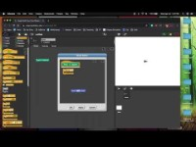
Custom block demonstration
Notes:
Demonstrate constructing a custom command block using a simple example. We have added a video to the slide to demonstrate creating a custom block.
Here is the link to the video - https://youtu.be/zMxMMnYlbGY

Slide 8

Lab 3.1: Drawing shapes (again)
In this lab, you will write code to draw regular polygons. This time, you will write custom blocks and abstraction to write a more efficient script.

Slide 9
Lab 3.1: Drawing shapes – Simple shapes
Write a Snap! script (or find one you've already written) to draw a square, an equilateral triangle, a regular pentagon and a regular octagon.
Look over the four programs. Do you notice sections that are very similar? What sections might be able to be abstracted into a separate block?

Slide 10
Lab 3.1: Drawing shapes – Custom blocks
Take your script that draws a square and turn it into a custom block.
Modify your custom block to use a variable for the number of sides. Set that variable's value to be 4 so that you still draw a square.
Modify your block so that it will work correctly for any number of sides greater than 2. Look closely at the angles in your four scripts section 1 and see if you can spot a pattern.
Notes:
Extensions:
Use the custom block in a program that asks the user for a number and then draws a regular polygon with that many sides. If the number given is less than 3, give an error message and do not draw anything.
Modify your custom block and program from the previous section so that the user can specify both the number of sides and the size of each side.

Slide 11

Debrief
Talk to your neighbor. Are there differences in your solutions?
When is a custom block helpful?
Notes:
Discuss one or two student submissions
Point out differences between different students’ solutions
Point out missed opportunities for abstraction (if any)
Discuss how this custom block can be useful

Slide 12

Exit ticket
In your notebook answer the following:
What is abstraction?
What is generalization?
What are some challenges when you create a custom block?
Discussion: Share what you were having trouble with.

